Slide 1




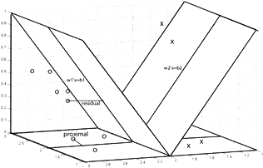

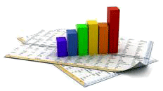

PreProcessing – Data Preparations
“Good data preparation is key to producing valid & reliable mining models.”
Taufik Sutanto taufik.sutanto@uinjkt.ac.id

Slide 2
Outline PreProcessing – Data Preparations
Why preprocess the data?
Data Integration and selection
Data Cleaning: Improving Quality
Data Transformation
Data Reduction
Data Distribution
Data Description
Studi Kasus Preprocessing Data Terstruktur dengan Python
Studi Kasus PreProcessing Data Text dengan Python
Visualisasi dasar Teks

Slide 3
First Thing First
Copy semua files yang dibutuhkan untuk kuliah Hari ini [Folder “Data Mining Minggu ke-7”]
Install Java SDK [Jika Java belum ada]
Extract Voyant.7z ke root, misal C:\VoyantServer
Pastikan Anaconda telah terinstall dan bekerja dengan baik, jika tidak (uninstall lalu) extract WinPython.zip ke root directory: C:\WinPython

Slide 4
Summary - Diskusi
Outliers ➔ deteksi?, Apa yang sebaiknya dilakukan? Mengapa?
Noise ➔ Apa yang disebut dengan noise? Deteksi? Apa yang harus dilakukan?
Dimension reduction. Mengapa? Bagaimana caranya?
Transformasi data. Mengapa? Fungsi Apa?
duplikasi (row/column). Apa yang harus dilakukan? Mengapa?
Variabel yang berkorelasi. Apa yang sebaiknya dilakukan? Mengapa?
Missing Data. Apa yang sebaiknya dilakukan? Mengapa?

Slide 5
Data Understanding: Relevance
What data is available for the task?
How much historical data is available?
How much of it is labelled?
Is this data relevant?
If so, what is the quality of data? How it can be improved?
How this data can be made relevant?
Is additional relevant data available?
Who is the data expert ?

Slide 6
What is Data or Dataset?
Attributes/ Variables/ Features/Colums/Fields
Collection of data objects and their attributes
An attribute is a property or characteristic of an object
Examples: eye color of a person, temperature, etc.
Associated with each attribute is a set of possible values or states, e.g., {male, female} for attribute Gender
A collection of attributes describes an object
Objects/Samples Observations/
Instances/Points
Cases/ tuples/ records/ vectors
Record Data: Row – Observation Units;
Column – Variables;

Slide 7
Data Pre-processing
Introduction: why & what?

Slide 8
Why pre-processing is needed?
Data in the real world is dirty
incomplete: lacking attribute values, lacking certain attributes of interest, or containing only aggregate data
e.g., occupation=“ ”
noisy: containing errors or outliers
e.g., Salary=“-10”
inconsistent: containing discrepancies in codes or names
e.g., Age=“42” Birthday=“03/07/1997”
e.g., Was rating “1,2,3”, now rating “A, B, C”
e.g., discrepancy between duplicate records

Slide 9
Data Understanding: Quality Enhancement
Mining dirty data is not much useful:
“Garbage in Garbage out”
Results in wrong inferences
Quality decisions are based on quality data
It is essential to understand data:
Sparsity: Only presence counts
Distribution: Centrality and dispersion
Data warehouse provides consistent integration of quality data

Slide 10
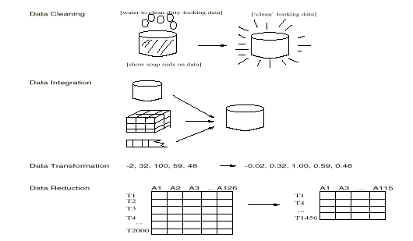
Data Preprocessing Tasks
identify or remove outliers, and resolve inconsistencies
Fill in missing values, smooth noisy data,
Normalization, aggregation and discretization
reduced representation in volume that produces the similar analytical results

Slide 11
Data Preparation: Major Steps
To organise data into a standard form that is ready for processing by mining algorithms
Data Gathering, Integration & Selection
data warehousing, Web crawling
Identification, extraction and integration of data
Data Cleaning
To prepare a high quality data
Data transformation
Generalize and/or normalize data
Data reduction (feature selection)
To prepare features that lead to the best predictive performance
Relevance analysis to remove the irrelevant or redundant attributes
60% of the time is consumed into preparing the data for mining

Slide 12
Time Line
Allotted Time
Projected:
Actual:
Dreaded:
(Data Acquisition)
Needed:
Data Preparation
Data Analysis
@Source: SAS Notes

Slide 13
Data Pre-processing
Variable Selection

Slide 14
Data Integration
Data integration:
combines data from multiple sources into a coherent store (typically from multiple databases)
Schema integration
integrate metadata from different sources
Entity identification problem: identify real world entities from multiple data sources, e.g., A.cust-id ≡ B.cust-#
Detecting and resolving data value conflicts
for the same real world entity, attribute values from different sources are different
possible reasons: different representations, different scales, e.g., metric vs. British units

Slide 15
Handling Redundant Data in Data Integration
Redundant data occur often when integration of multiple databases is required.
The same attribute may have different names in different databases.
One attribute may be a “derived” attribute in another table, e.g., annual revenue
Redundant data may be able to be detected by co-relational analysis.
Careful integration of the data from multiple sources may help reduce/avoid redundancies and inconsistencies and improve mining speed and quality.

Slide 16
Data Selection
Active variables
Input variables
directly use to make predictions, distinguish segments, etc.
Avoid irrelevant and redundant variables
Target variables (or Class Labels)
Avoid false predictors
Supplementary variables
useful in visualising and explaining the results
Identification type of attributes such as name, address and so on.

Slide 17
Identification of Good Features as Input variables
The set of values (beside class labels) used to construct the model are called the features.
Example of features:
Information: age, location, occupation, amount currently in bank account, number of words, etc.
Answers to questions: presence or absence of symptoms, blood test results, multiple choice questions answers
Recorded history: number and dates of previous operations/tests, amounts of operations
Words: type of words present or absent or frequent, list of words, or patterns

Slide 18
Finding Features
Features can be extracted from one or several databases
Some features can be computed based on existing information in the database
Average salary over 10 years
Number of transactions per year
Some features can be deduced/gathered from external data sources
Low/High socio economical status based on postcode
Rainfall, weather information based on location coordinates
Type of word (positive vs negative, verb vs. noun)
Importance of email sender (based on company hierarchy)

Slide 19
Example of Good features
Three Objects: Blue small ball; Red small ball; Blue Big ball
large
1
Size
Large
small
0
red
blue
0
Blue
1
Colour
S1
Dot product
Sim(S1, S2) = 1*1+0*1=1
Sim(S1, S3) = 1*0 + 1.*0 = 0
Distance = 1/sim
1
[1,1]
Large
S3
S2
0
[0,0]
[1,0]
0
Blue
1

Slide 20
Another Example: Derived Features
Claim Accident
Date Time
11nov96 102396/12:38
22dec95 012395/01:42
26apr95 042395/03:05
02jul94 070294/06:25
08mar96 123095/18:33
15dec96 061296/18:12
09nov94 110594/22:14
Delay Season Dark
19 fall 0
333 winter 1
3 spring 1
0 summer 0
69 winter 0
186 summer 0
4 fall 1

Slide 21
Feature Representation: Example
Long-Narrow
Acct type
2133 MTG
2133 SVG
2133 CK
2653 CK
2653 SVG
3544 MTG
3544 CK
3544 MMF
3544 CD
3544 LOC
Short-Wide
Acct CK SVG MMF CD LOC MTG
2133 1 1 0 0 0 1
2653 1 1 0 0 0 0
3544 1 0 1 1 1 1

Slide 22
Derived Features: Roll Up
HH Acct Sales
4461 2133 160
4461 2244 42
4461 2773 212
4461 2653 250
4461 2801 122
4911 3544 786
5630 2496 458
5630 2635 328
6225 4244 27
6225 4165 759
HH Acct Sales
4461 2133 ?
4911 3544 ?
5630 2496 ?
6225 4244 ?

Slide 23
Feature Selection: Target Value?
Frequent Flying VIP
Flier Month Mileage Member
10621 Jan 650 No
10621 Feb 0 No
10621 Mar 0 No
10621 Apr 250 No
33855 Jan 350 No
33855 Feb 300 No
33855 Mar 1200 Yes
33855 Apr 850 Yes
Rolling Up Longitudinal Data

Slide 24
Data Pre-processing
Quality Enhancement

Slide 25
Data Cleaning: Improving Quality
Maintain the data quality by handling
Noise (incorrect and/or redundant data)
Can be indicated by outliers
Missing Data
not present in the data
those deleted during noise detection
Correct inconsistent data
Small and stale data
Assessing data quality may consume 20%-40% of the whole process

Slide 26
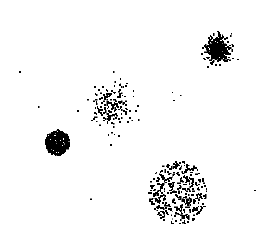
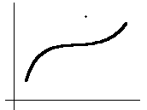
Noisy Data
Noise: random error or variance in a measured variable
Noise can happen because of
faulty data collection instruments
data entry mistakes
data transmission problems
inconsistency in naming convention
Outliers are data objects with characteristics that are considerably different than most of the other data objects in the data set
Different outliers
Valid: CEO’s salary,
Noisy: One’s age = 200, widely deviated points

Slide 27
Correcting Noisy Data
Binning method:
first sort data and partition into (equi-depth or equal numbers) bins
then smooth by bin means, by bin median, by bin boundaries, etc.
Clustering
detect and remove outliers
Regression
smooth by fitting the data into regression functions
Combined computer and human inspection
detect suspicious values and check by human (e.g., deal with possible outliers)

Slide 28
Binning Method
Let the data be { 4, 8, 15, 21,21,24,25,28,34}
Sort them into three (3 ) bins as
{4,8,15}, {21,21,24} {25,28,34}
Smoothing by bin means:
{9,9,9}, {22,22,22}, {29,29,29}
Smoothing by bin boundaries:
{4,4,15}, {21,21,24}, {25,25,34}

Slide 29
Cluster Analysis

Slide 30
Regression/Curve Fitting/Smoothing
y
Y1
Y1’
y = x + 1
X1
x

Slide 31
Missing Data
Data is not always available
E.g., many tuples have no recorded value for several attributes (for e.g. customer income in sales data)
Missing data happens due to
Data wasn’t capture due to equipment malfunction;
inconsistent with other recorded data and thus application program might have deleted the data;
data not entered due to misunderstanding (I thought that you will do it!)
certain data may not be considered important at the time of entry
not register history or changes of the data
Missing data values need to be inferred or estimated.

Slide 32
Handling Missing Data
Age | Income | Religion | Gender
23 | 24,200 | Muslim | M
39 | ? | Christian | F
45 | 45,390 | ? | F
Fill missing values using aggregate functions (e.g., average) or probabilistic estimates on global value distribution
E.g., put the average income here, or put the most probable income based on the fact that the person is 39 years old
E.g., put the most frequent religion here

Slide 33
Missing Value Imputation
Ignore the tuple: easy but not effective when the percentage of missing values per attribute varies considerably.
Fill in the missing value manually: tedious + infeasible?
Use a global constant to fill in the missing value: e.g., “unknown”, -∝ or a new value/class?
Use the attribute mean to fill in the missing value if the attribute is numeric or majority value if attribute is categorical

Slide 34
Missing Value Imputation: Sophisticated Ways
Use the attribute mean for all samples belonging to the same class to fill in the missing value: smarter
Use the most probable value to fill in the missing value: inference-based such as Bayesian formula or decision tree.
Each of these methods can be applicable to a certain situation.
No one method is universally applied.

Slide 35
Example: Data Quality Identify Errors, Outliers, and Missing
cking #cking ADB NSF dirdep SVG bal
Y 1 468.11 1 1876 Y 1208
Y 1 68.75 0 0 Y 0
Y 1 212.04 0 6 0
. . 0 0 Y 4301
y 2 585.05 0 7218 Y 234
Y 1 ­47.69 2 1256 238
Y 1 4687.7 0 0 0
. . 1 0 Y 1208
Y . . . 1598 0
1 0.00 0 0 0
Y 3 89981.12 0 0 Y 45662
Y 2 585.05 0 7218 Y 234

Slide 36
Data Transformation: Why?
Depends on the type of solution or a prediction method to be applied
linear discriminates and neural nets that use arithmetic operations
prefer numerical values in normalised form
decision trees or rules that compute in terms of true or false
prefer categorical values
Nearest-neighbour methods that measure case similarity (Distance based)
prefer numerical values data

Slide 37
Data Transformation: How?
Discretisation
converting quantitative variables into categorical variables
assigning the values of the input variable into ranges
Normalisation
scaling to a specified range
decimal scaling
standard deviation normalisation
Smoothing
reducing the number of values an attribute can have

Slide 38
Simple Discretization Methods: Binning
Example: customer ages
number of values
Equi-width binning:
0-10
10-20
20-30
30-40
40-50
50-60
60-70
70-80
Equi-depth binning:
0-22
22-31
48-55
62-80
38-44
32-38
44-48
55-62

Slide 39
Data Reduction Strategies
Why data reduction?
A database/data warehouse may store terabytes of data
Complex data analysis/mining may take a very long time to run on the complete data set
The Curse of Dimensionality
Data reduction
Obtain a reduced representation of the data set that is much smaller in volume but yet produce the same (or almost the same) analytical results
1–D
3–D
2–D

Slide 40
Dimensionality Reduction
Feature selection (i.e., attribute subset selection):
Select a minimum set of attributes such that the probability distribution of different classes given the values for those attributes is as close as possible to the original distribution given the values of all features
Reduction in size and easier to understand.
A number of heuristic methods (due to exponential number of choices):
decision-tree induction

Slide 41
Example of Decision Tree Induction
Initial attribute set:
{A1, A2, A3, A4, A5, A6}
A4 ?
A1?
A6?
Class 1
Class 2
Class 1
Class 2
>
Reduced attribute set: {A1, A4, A6}

Slide 42
Histograms
A popular data reduction technique
Divide data into buckets and store average (sum) for each bucket
Can be constructed optimally in one dimension using dynamic programming
Related to quantization problems.

Slide 43
Data Pre-processing
Data Distribution

Slide 44
Data Distribution
Fitting the right-size
data to model
My model fits the
training data perfectly.
I’ve struck it rich!

Slide 45
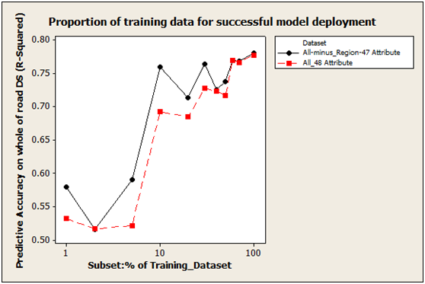
Data Distribution: Why?
Entire data is not required in model building.

Slide 46
Data Distribution
Allow a mining algorithm to run on smaller datasets
Allow the resultant models to evaluate on an independent dataset.
Two main types:
Batch Testing - % distribution
N-fold cross validation
Two ways to Choose a representative subset of the data
Random Sampling
It may have very poor performance in the presence of skew
Stratified sampling (for skewed data)
Approximate the percentage of each class (or subpopulation of interest) in the overall dataset
Training
Validation
Test

Slide 47
Data Distribution: Batch testing
Labeled
Training set
Keep a portion of the labeled samples for testing:
Test/Train split
Allows to compare
-Different algorithms
-Different training parameters
Labeled
Test set
15 % or 20% or…

Slide 48
Data Distribution : n-fold cross validation
Labeled
dataset
1
Example: n=10
Apply batch testing to different splits to test robustness
Train 1-9 Test 10
Train 1-8+10 Test 9
…
Average of 10 accuracies
2
…
10

Slide 49
Random Sampling
Subset 1
Subset 2
Subset 3
Raw Data

Slide 50
Sratified Sampling
Raw Data
Cluster/Stratified Sample

Slide 51
Stratified Sampling: Example
OK
Fraud

Slide 52
Final Remarks

Slide 53
Data Size: Final Observation
Number of instances
Rule of thumb: 5,000 or more desired
if less, results are less reliable; use cross-validation
Number of attributes
Rule of thumb: for each attribute value, 10 or more instances
If #attributes>25, use feature selection
Number of targets
Rule of thumb: >500 instances for each class
if very unbalanced, use stratified sampling

Slide 54
Data Preparation - Summary
It is a multi-step time-consuming task.
Data Acquisition - Select Data of Interest
Data Quality Improvement - Clean data
Data Transformation - transform the pre-processed data according to the analytical data model
data discretisation, data normalisation
Dimensionality Reduction – Select the best feature set for data modelling
Data Distribution - Select an appropriate data set and/or sampling strategy
need to reduce the large database

Slide 55
References
J. Han and M. Kamber. Data Mining: Concepts and Techniques. Morgan Kaufmann, 2012, third edition.
Chapters 2 & 3
Discovering Data Mining, by Cabena, et al., 1997.
Predictive Data Mining, by Weiss and Indurkhya, 1999.
Applying Data Mining Techniques Using Enterprise Miner Course Notes”, by SAS Institute Inc., 2002.
D. Pyle. Data Preparation for Data Mining. Morgan Kaufmann, 1999.

Slide 56
Data Description

Slide 57
Measuring the Central Tendency
Mean (algebraic measure) (sample vs. population):
Weighted arithmetic mean:
Trimmed mean: chopping extreme values
Median: A holistic measure
Middle value if odd number of values, or average of the middle two values otherwise
Estimated by interpolation (for grouped data):
Mode
Value that occurs most frequently in the data
Unimodal, bimodal, trimodal
Empirical formula:

Slide 58
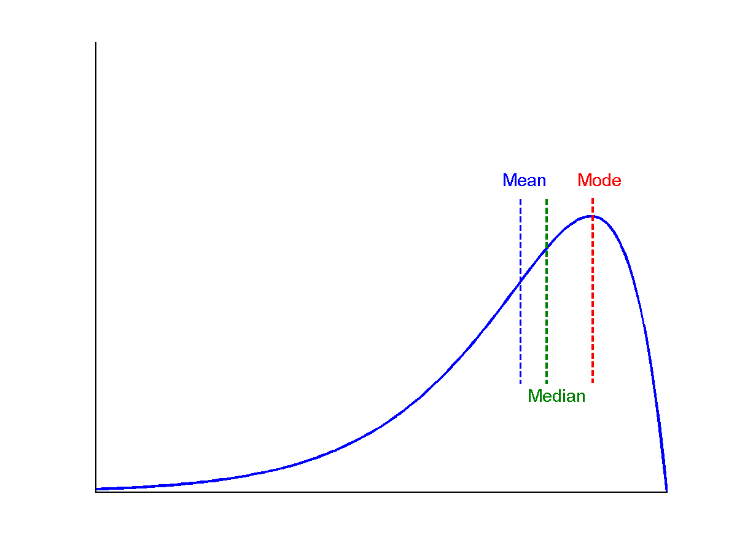
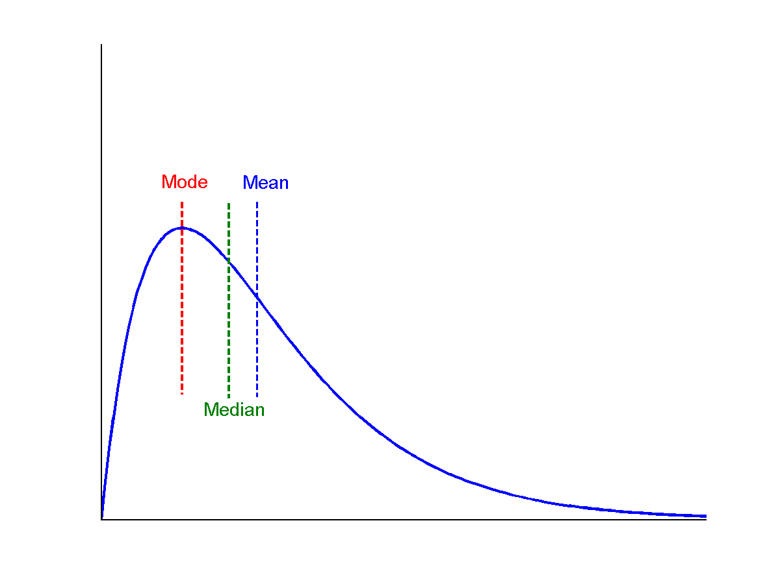
Symmetric vs. Skewed Data
Median, mean and mode of symmetric, positively and negatively skewed data

Slide 59
Measuring the Dispersion of Data
Quartiles, outliers and boxplots
Quartiles: Q₁ (25th percentile), Q₃ (75th percentile)
Inter-quartile range: IQR = Q₃ – Q₁
Five number summary: min, Q₁, M, Q₃, max
Boxplot: ends of the box are the quartiles, median is marked, whiskers, and plot outlier individually
Outlier: usually, a value higher/lower than 1.5 x IQR
Variance and standard deviation (sample: s, population: σ)
Variance: (algebraic, scalable computation)
Standard deviation s (or σ) is the square root of variance s² ⁽or σ²⁾

Slide 60
Properties of Normal Distribution Curve
The normal (distribution) curve
From μ–σ to μ+σ: contains about 68% of the measurements (μ: mean, σ: standard deviation)
From μ–2σ to μ+2σ: contains about 95% of it
From μ–3σ to μ+3σ: contains about 99.7% of it

Slide 61
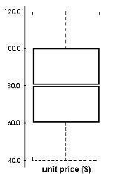
Boxplot Analysis
Five-number summary of a distribution:
Minimum, Q1, M, Q3, Maximum
Boxplot
Data is represented with a box
The ends of the box are at the first and third quartiles, i.e., the height of the box is IRQ
The median is marked by a line within the box
Whiskers: two lines outside the box extend to Minimum and Maximum

Slide 62
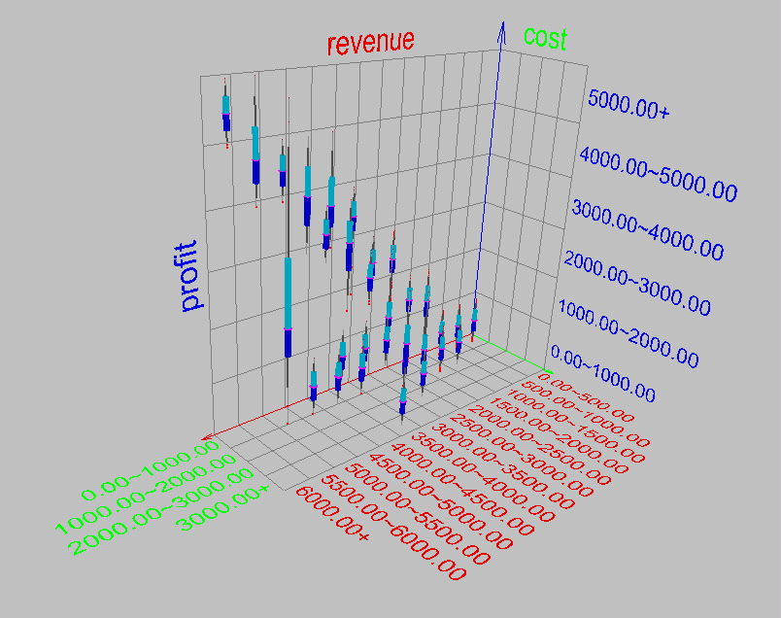
Visualization of Data Dispersion: Boxplot Analysis

Slide 63
Histogram Analysis
Histogram: Graph display of tabulated frequencies, shown as bars
It shows what proportion of cases fall into each of several categories
Differs from a bar chart in that it is the area of the bar that denotes the value, not the height as in bar charts, a crucial distinction when the categories are not of uniform width
The categories are usually specified as non-overlapping intervals of some variable. The categories (bars) must be adjacent
Notes:
JH: A better and BASIC histogram figure --- because this one overlaps with a later one!

Slide 64
Histograms Often Tell More than Boxplots
The two histograms shown in the left may have the same boxplot representation
The same values for: min, Q1, median, Q3, max
But they have rather different data distributions

Slide 65
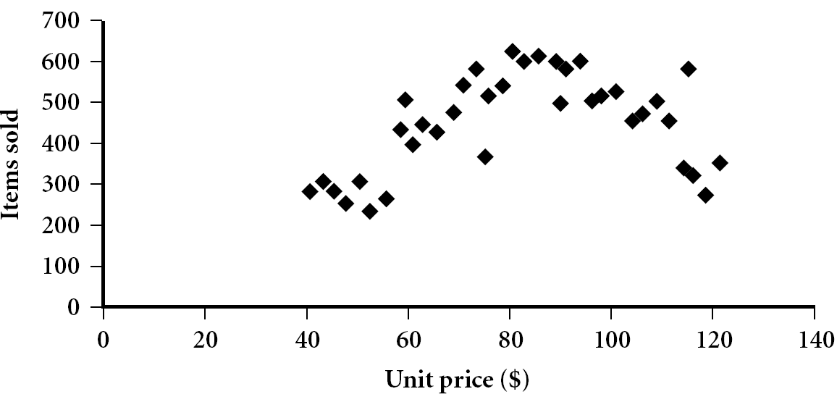
Scatter plot
Provides a first look at bivariate data to see clusters of points, outliers, etc
Each pair of values is treated as a pair of coordinates and plotted as points in the plane
Notes:
Need a better and more MEANINGFUL scatter plot! -JH

Slide 66
Positively and Negatively Correlated Data
The left half fragment is positively correlated
The right half is negative correlated

Slide 67
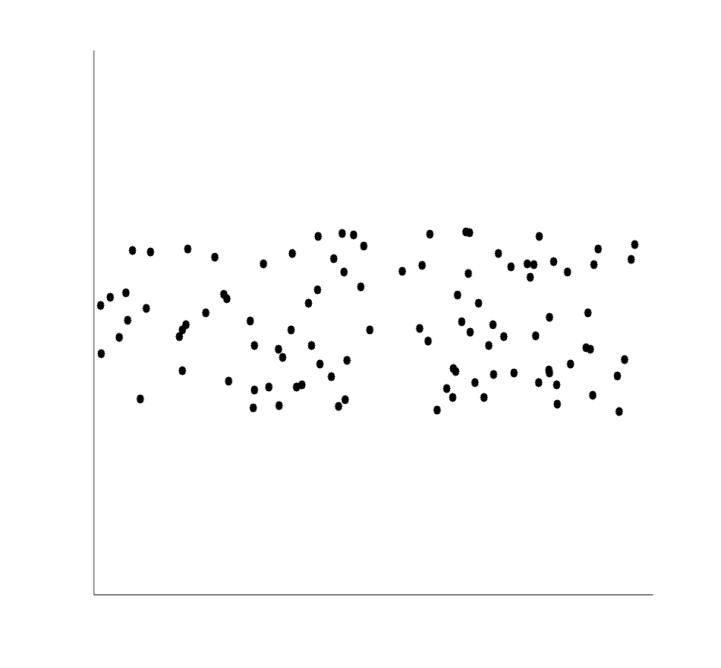
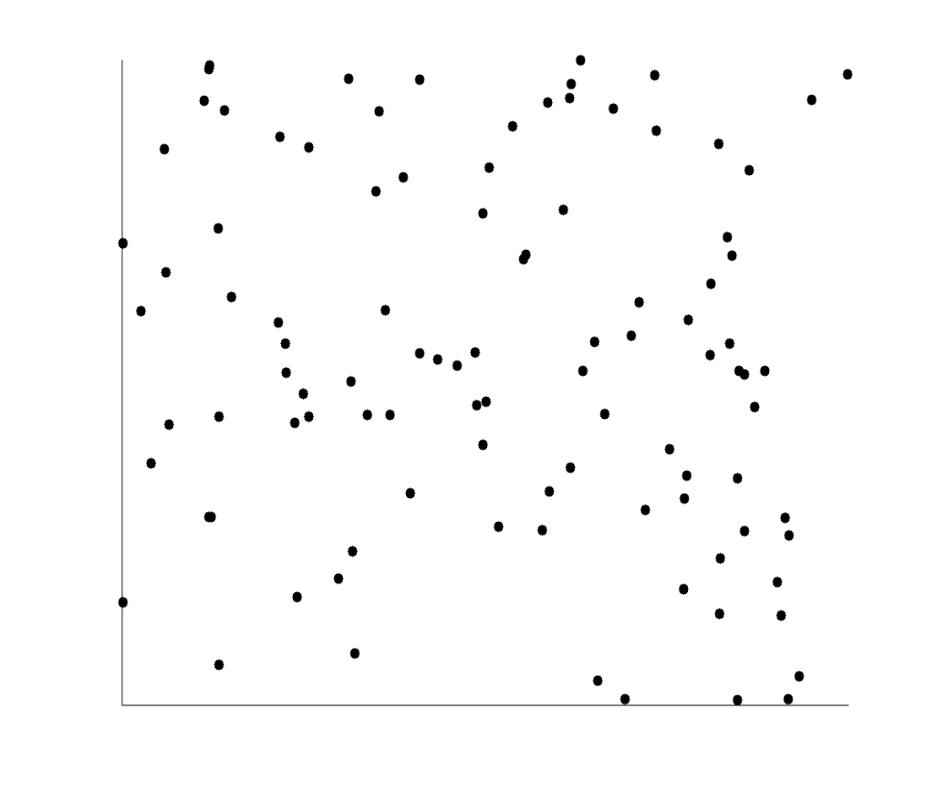
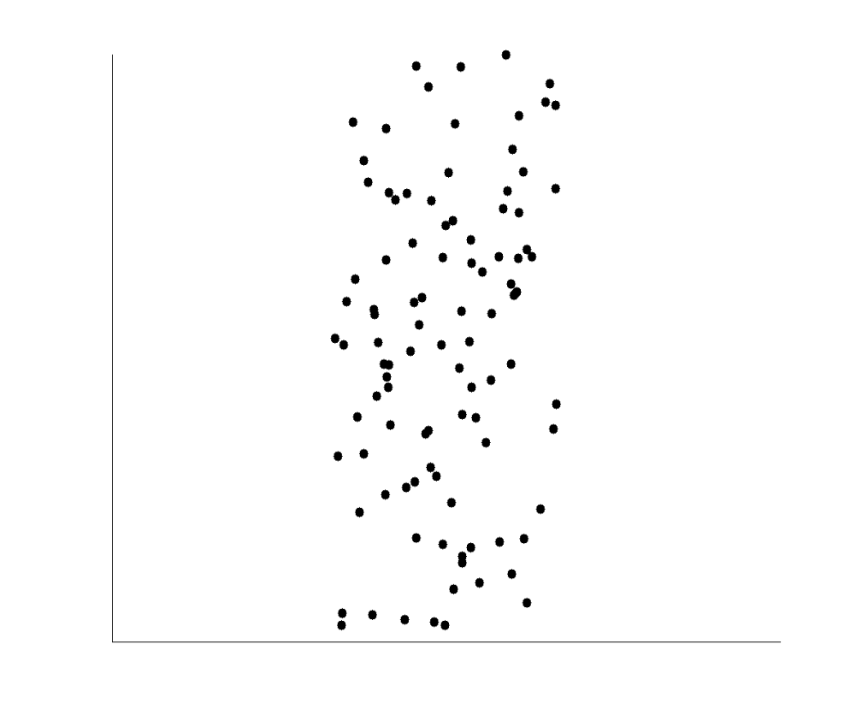
Uncorrelated Data

Slide 68
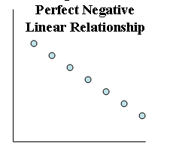
Data showing Perfect Linear Relationship
A scatter plot illustrating a perfect linear relationship between two quantitative variables
Linear relationship occurs when all the data points lie exactly on a straight line.
We can predict perfectly the value of one variable from the other.
When two variables tend to increase together, we say the variables have a positive relationship; when one variable tends to decrease as another variable increases, we say the variables have a negative relationship.
Very rarely, if ever, we observe in real data a relationship where one variable can perfectly be predicted from another.
With real data, some component of random variation is always present.

Slide 69
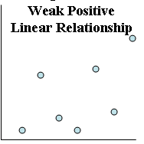
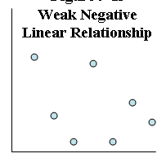
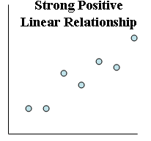
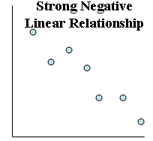
Data showing Imperfect Linear Relationship
These scatter plots of a type more likely to be observed with real data
These data points lie relatively close to, but not exactly on, a straight line.
One variable cannot be predicted perfectly from the other variable, but one variable can be predicted from the other with a relatively strong degree of accuracy.
These data points seem widely scattered around a straight line.
One variable cannot be predicted perfectly from the other variable, but one variable can be predicted from the other with some degree of accuracy.

Slide 70
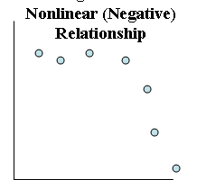
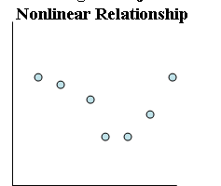
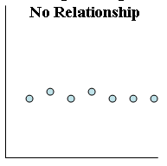
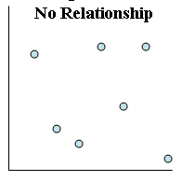
No Relationship Data
Nonlinear Relationship Data
Scatter plots illustrating independence between two quantitative variables
Scatter plots illustrating
nonlinear relationships
In both scatter plots, we find no evidence that the value of one variable is significantly influenced by changes in the value of the other variable.
In other words, there appears to be no relationship between the two variables in each of these scatter plots.
We say that the variables are independent.
Variable on the horizontal axis increases in value, the other variable will sometimes tend to increase and sometimes tend to decrease. Or sometimes will not change.
Linear relationships are of only two types: positive and negative.
However, many different types of nonlinear relationships are possible, but there is no easy way to classify all of them

Slide 71
Sekian Terima Kasih
Taufik Sutanto taufik.sutanto@uinjkt.ac.id

